Slide 1

ERP System for College Management
Group - 3

Slide 2
Team Members:
MEMBER ID | MEMBER NAME
2567416 | Kiran Raj V
2567953 | Kriti Srivastava(Team Lead)
2569171 | Lipsa Nayak
2567234 | Mayank Tiwari
2567369 | Nithya X
2569105 | Nookanaboyena Karthik
2566995 | Obili Govindu Gari Manmadha Reddy
2567378 | Obulareddy Ganga Dinesh Reddy

Slide 3
Table of Contents:
Introduction
Proposed System
Advantages of Proposed System
Tools and Technologies
Architecture
Admin Module
Faculty Module
Student Module
ER Diagram
Output
Unit Testing
Functional Testing
Advantages
Future Scope
Conclusion

Slide 4
Introduction:
1.To develop a secure and user-friendly ERP of college management system that allows student and faculty to manage their accounts and perform different functionality.
2. The system should prioritize data privacy, offer real-time updates and ensure seamless and integration to enhance overall experience.

Slide 5
Proposed System:
Web application technology is beneficial for college management system.
In this system data is stored in a centralized database, making it easy to access and manage from anywhere.
It is fast and efficient, and uses automation to reduce errors.
It is user-friendly and easy to learn, with a modern and intuitive interface.
It is integrated, allowing data to be shared seamlessly between different departments.
It is mobile-friendly, allowing it to be accessed from anywhere on any device.

Slide 6
Advantages of Proposed System:
Efficiency
Data Accessibility
Cost Savings
Enhanced security
Reduced workload

Slide 7

Tools and Technologies:
Front-End: Angular Server-side: Spring Boot
Back-End: MYSQL Server: Tomcat

Slide 8
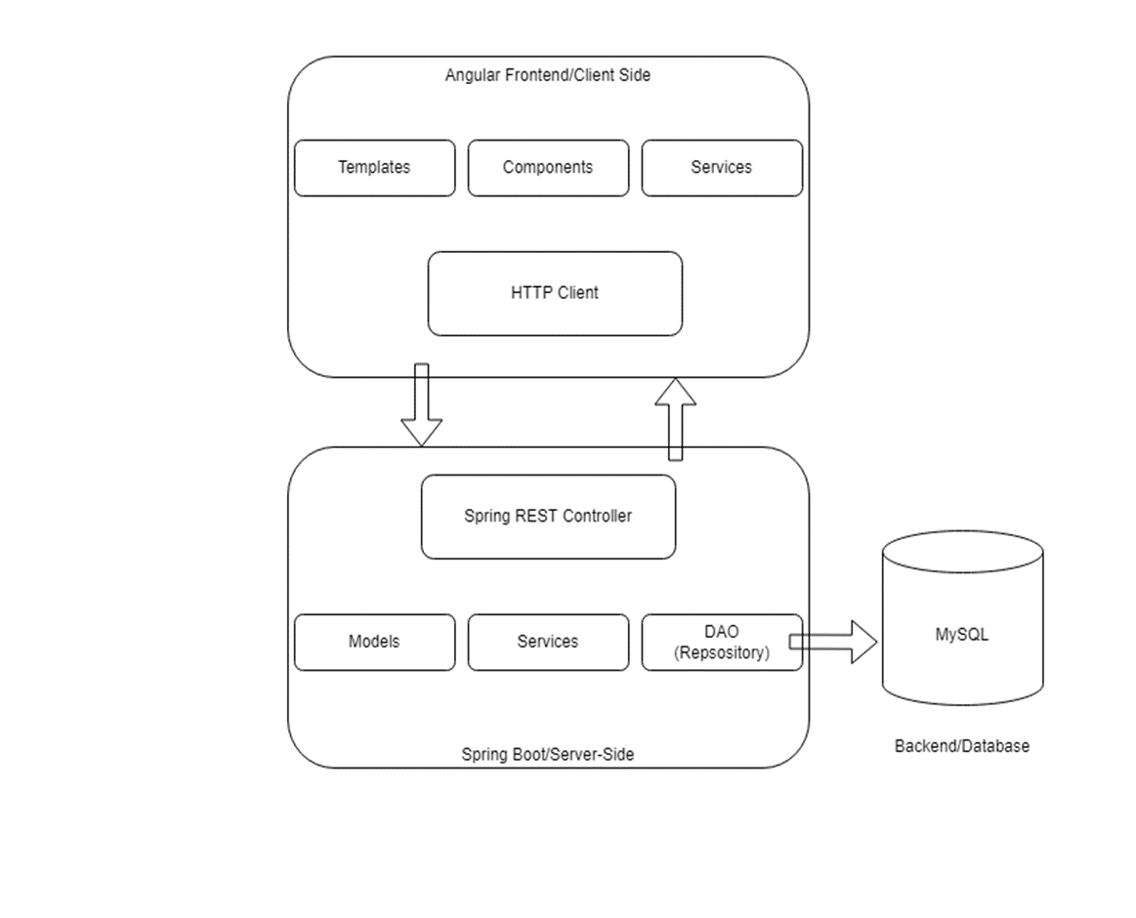
Architecture(Client-Server):

Slide 9
Admin Module:
Login
Dashboard
Students
Faculties
Other Staff
Branch
Reports

Slide 10
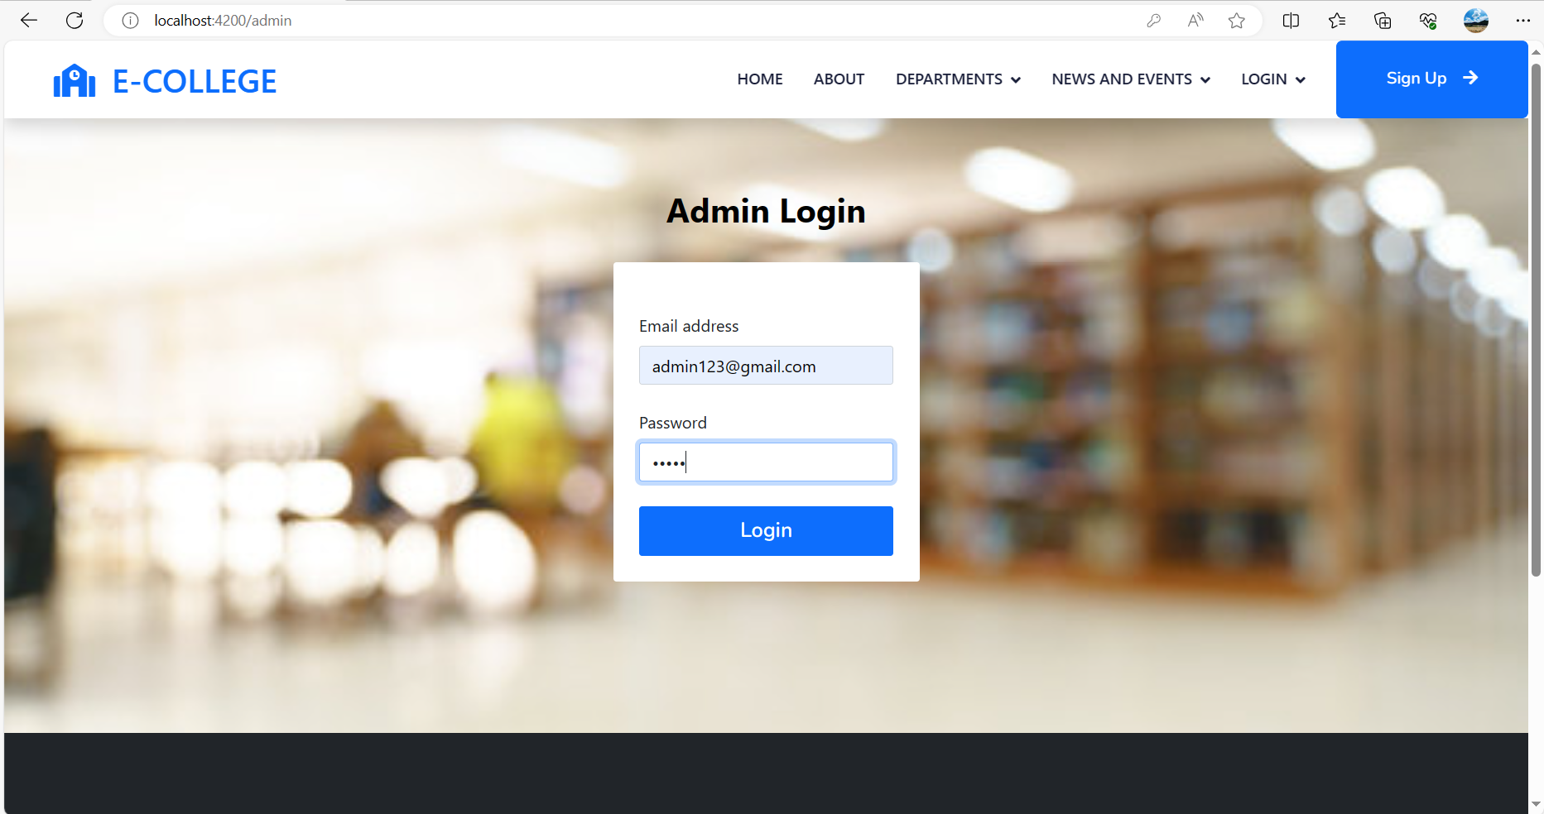
Admin login:

Slide 11
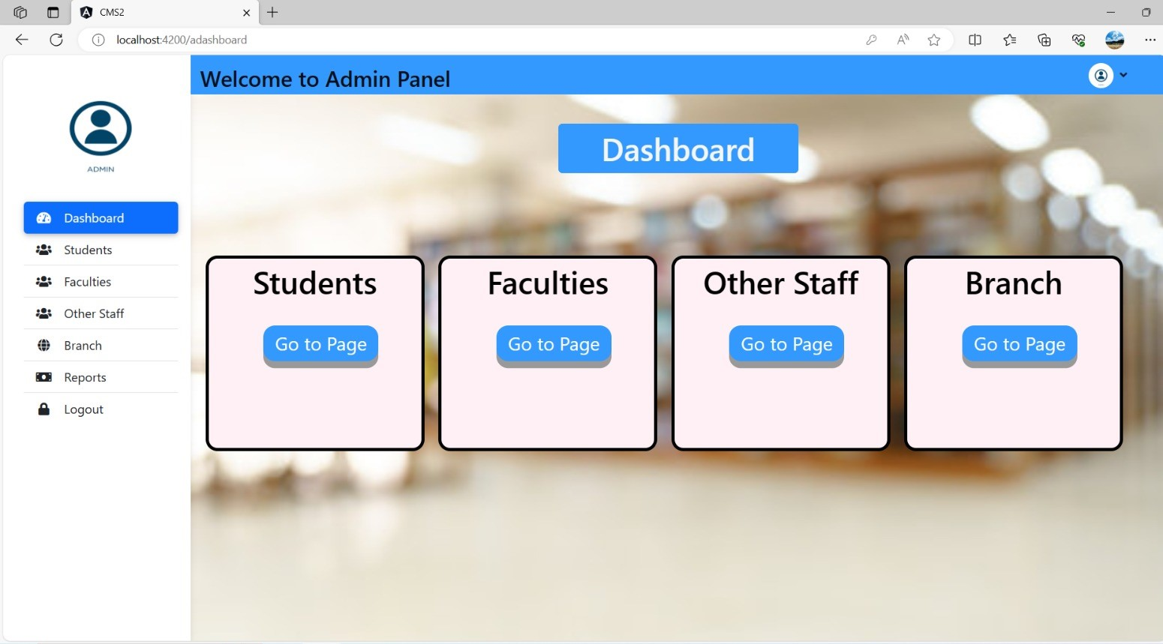
Admin Panel(Dashboard):

Slide 12
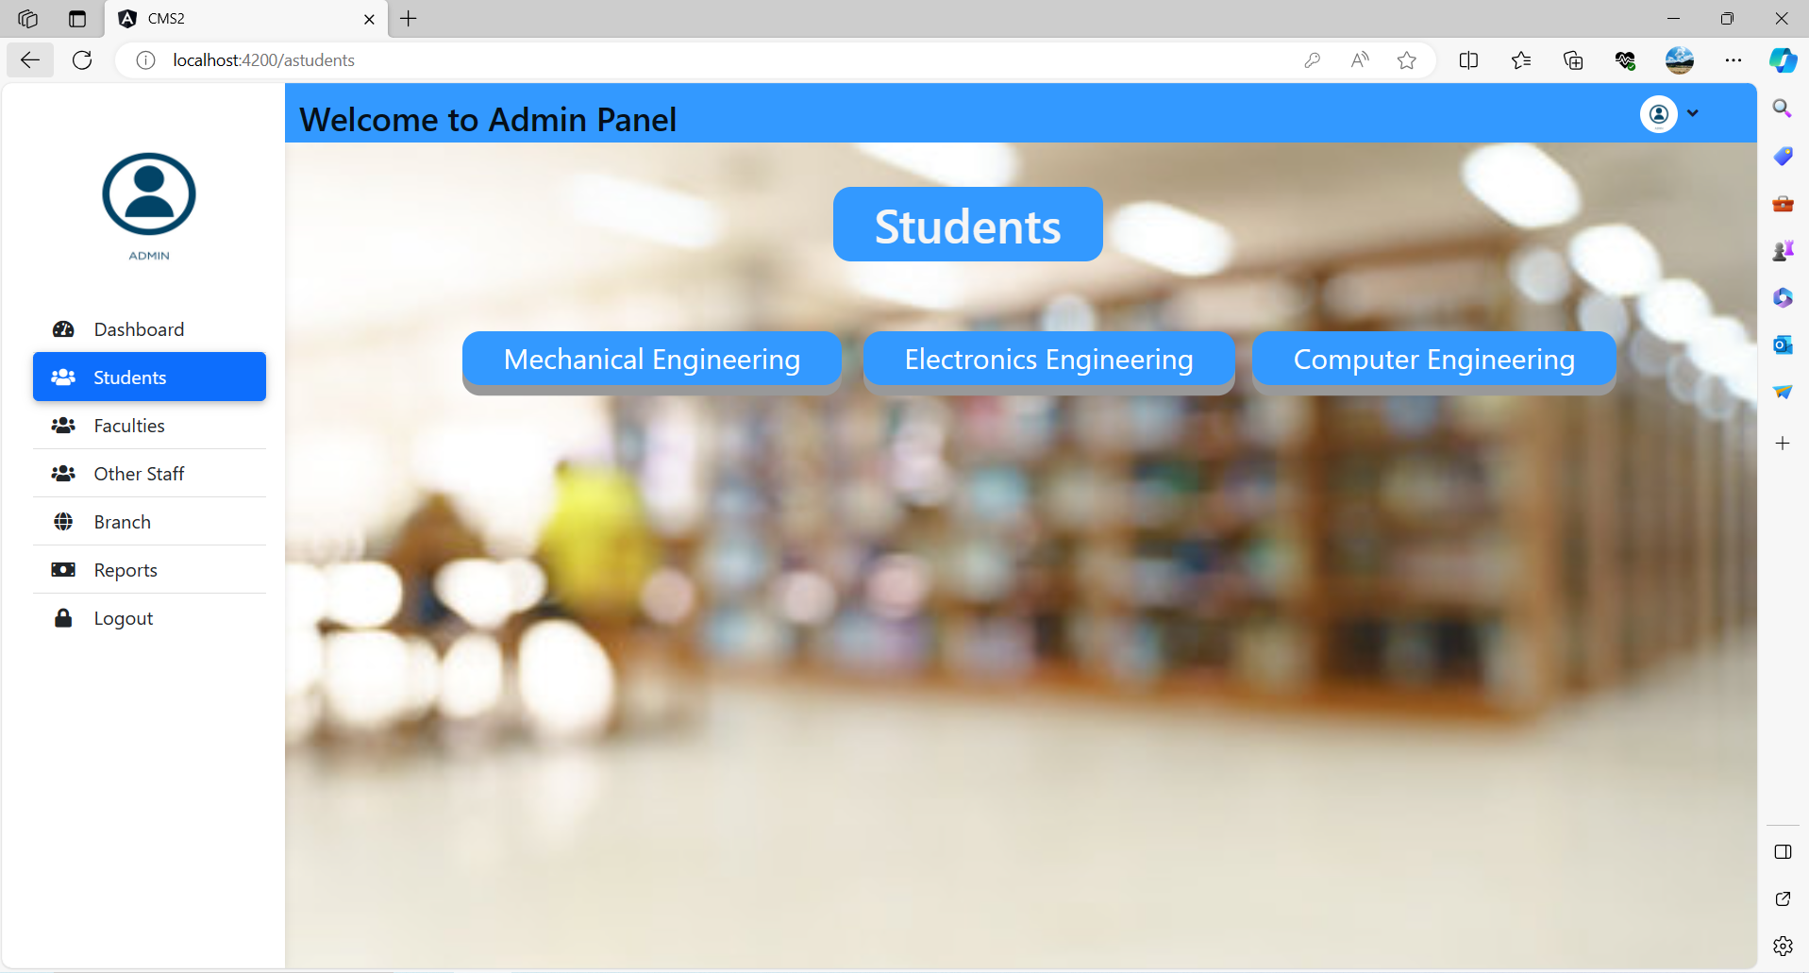
Admin Panel(Students):

Slide 13
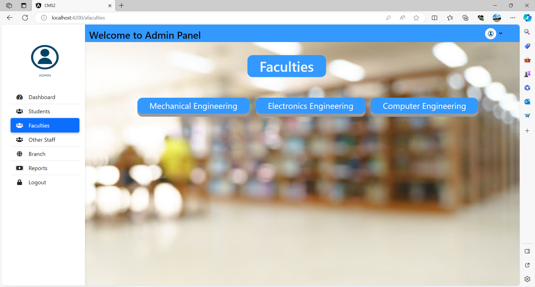
Admin Panel(Faculties):

Slide 14
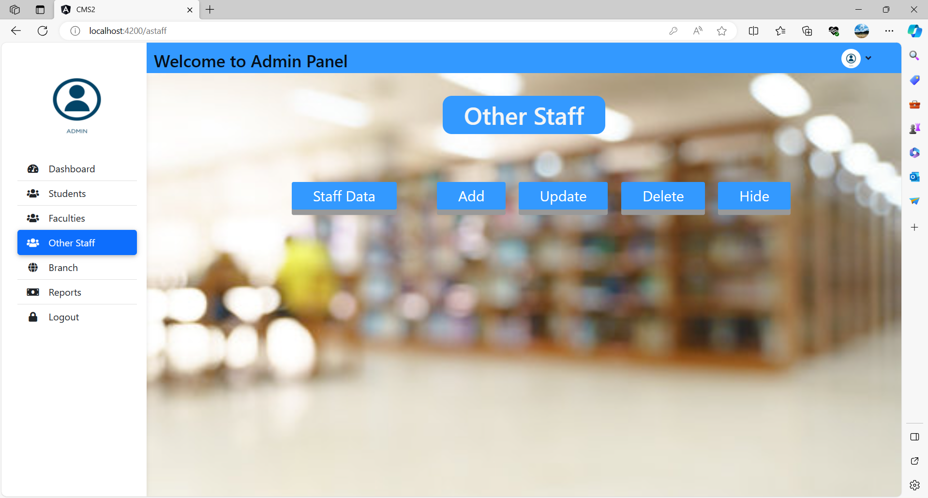
Admin Panel(Other staff):

Slide 15
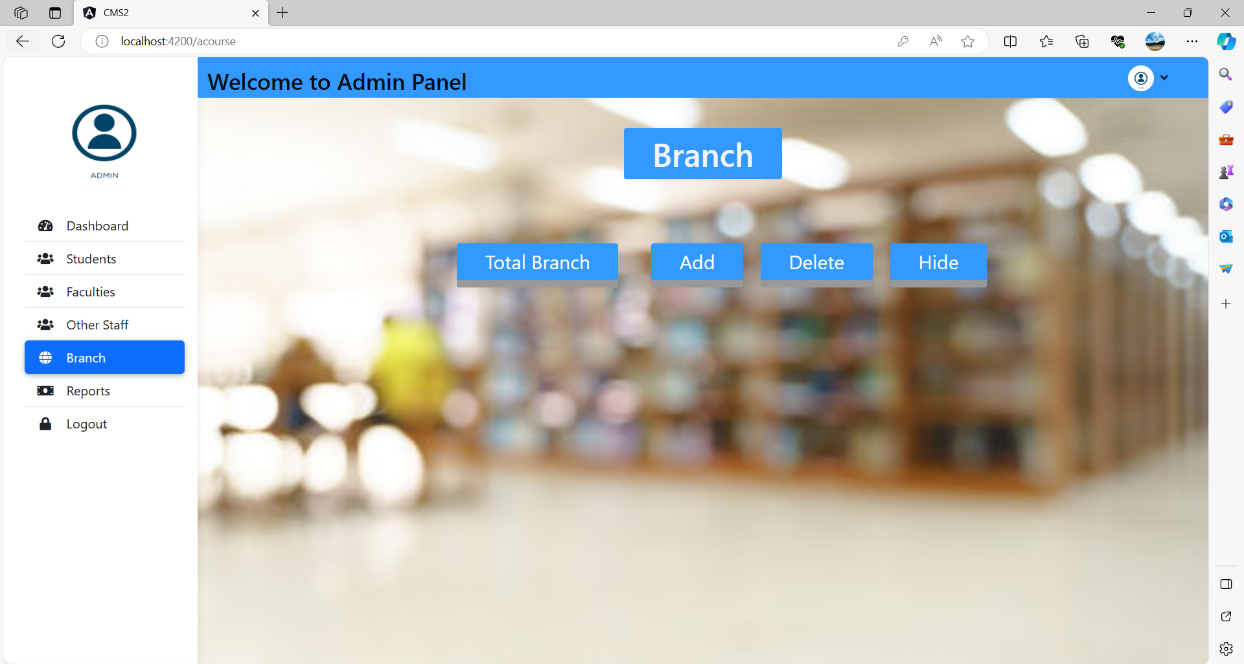
Admin Panel(Branch):

Slide 16
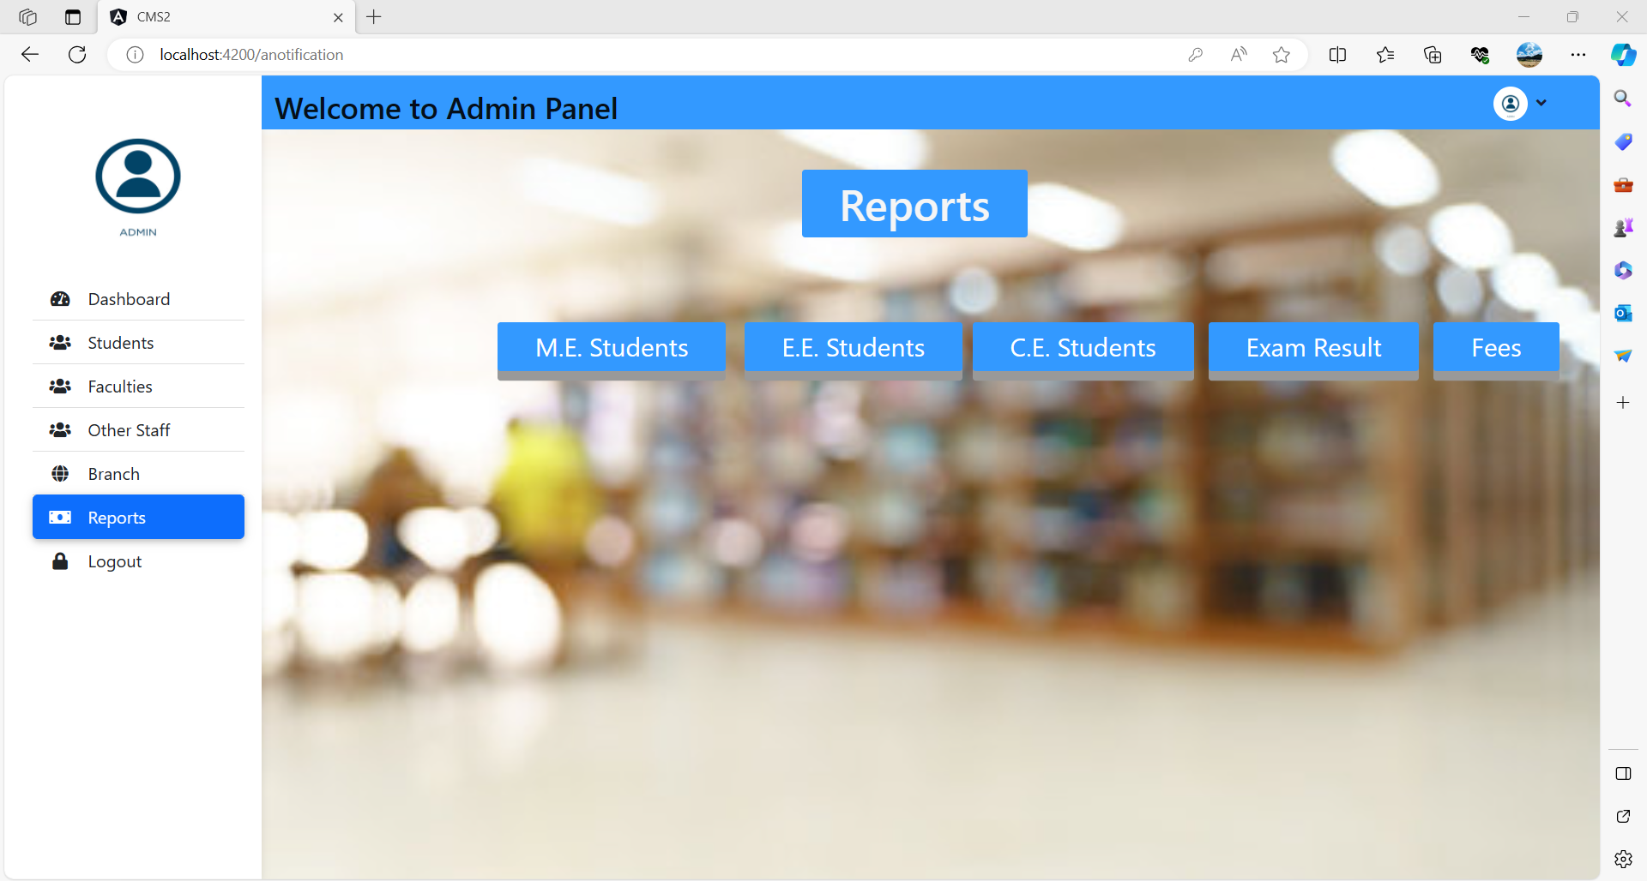
Admin Panel(Reports):

Slide 17
Faculties:
Login
Dashboard
Students
Result

Slide 18
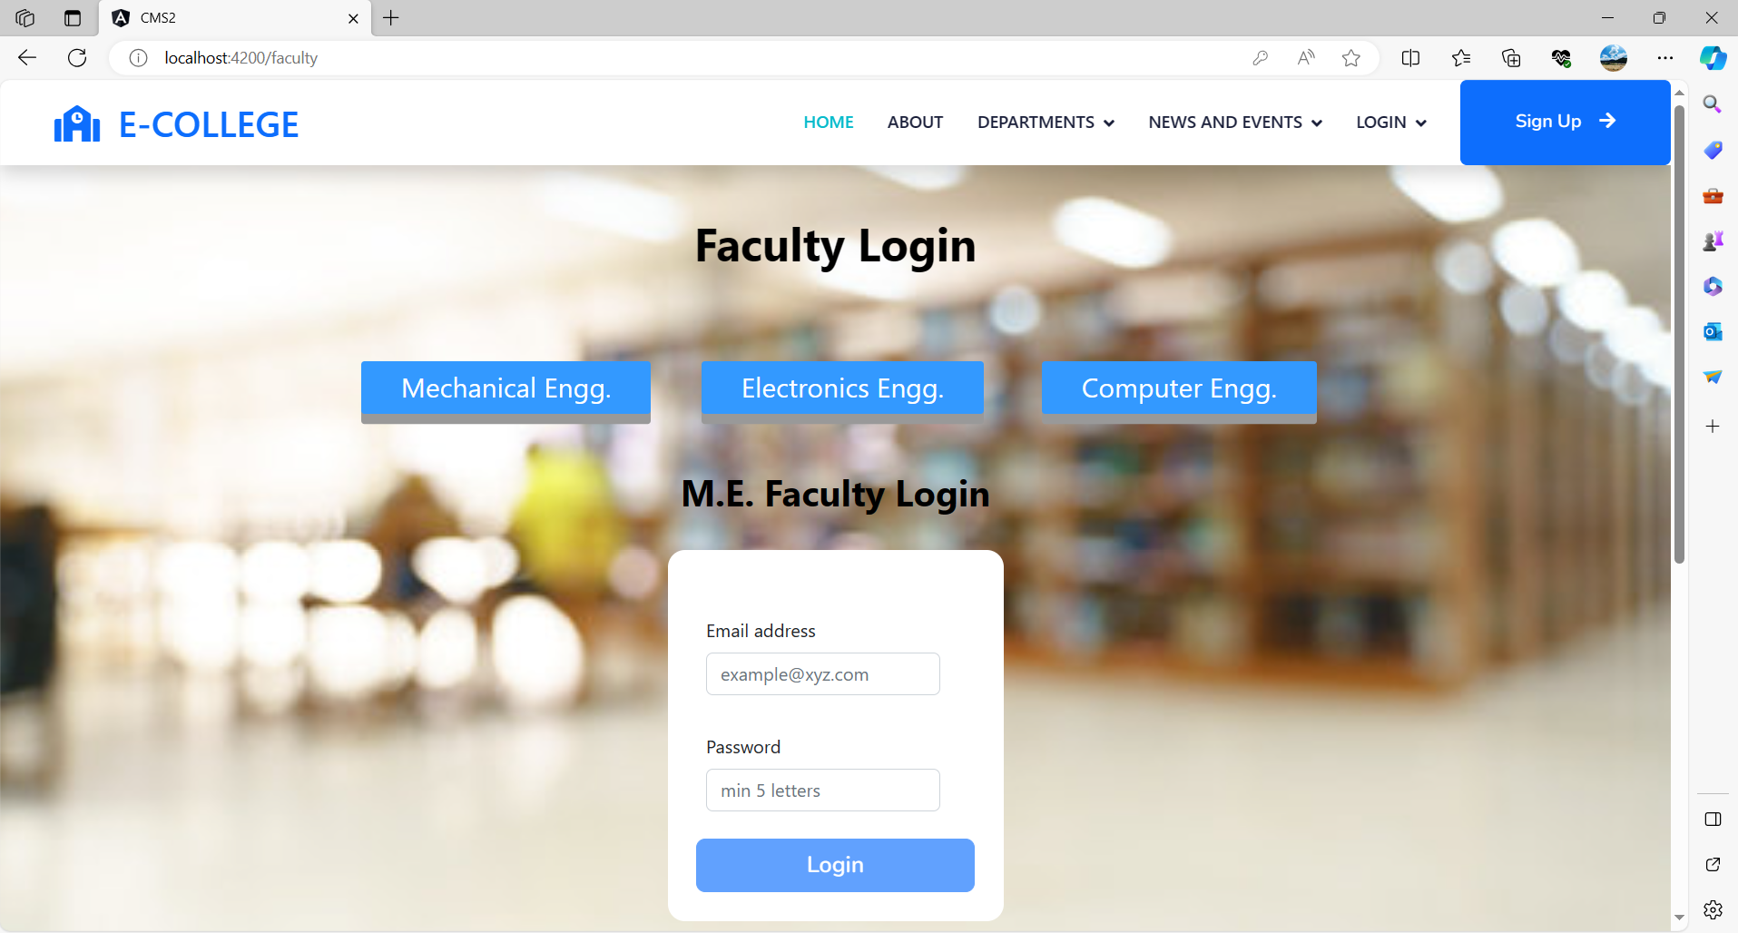
Faculty Panel (login):

Slide 19
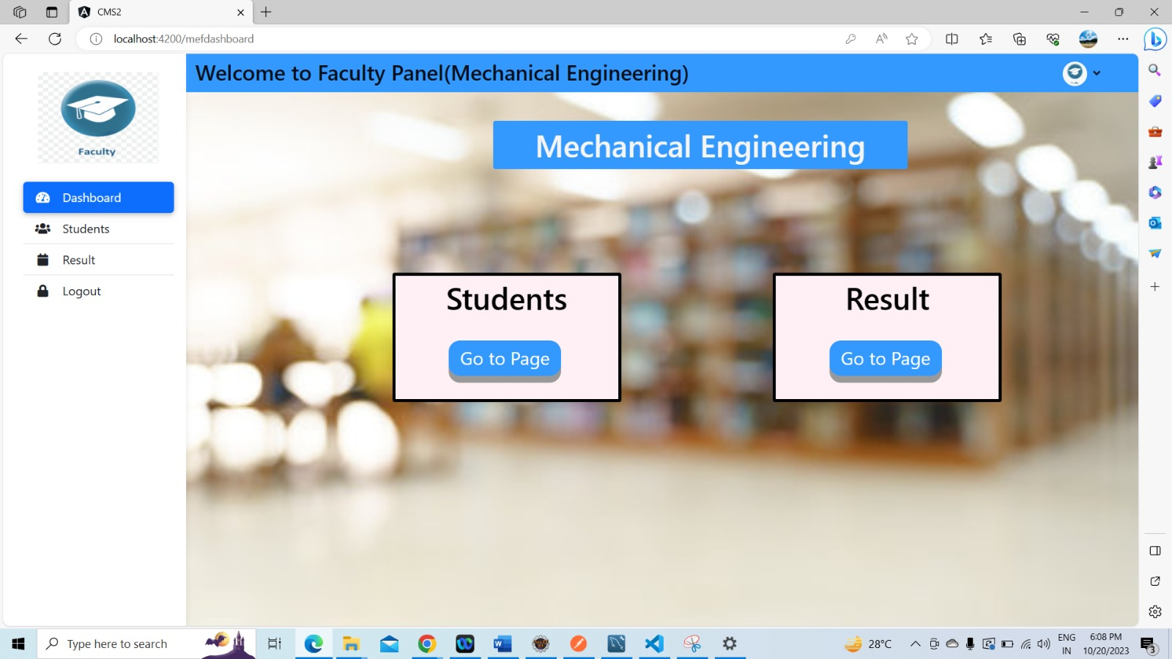
Faculty Panel (Dashboard):

Slide 20
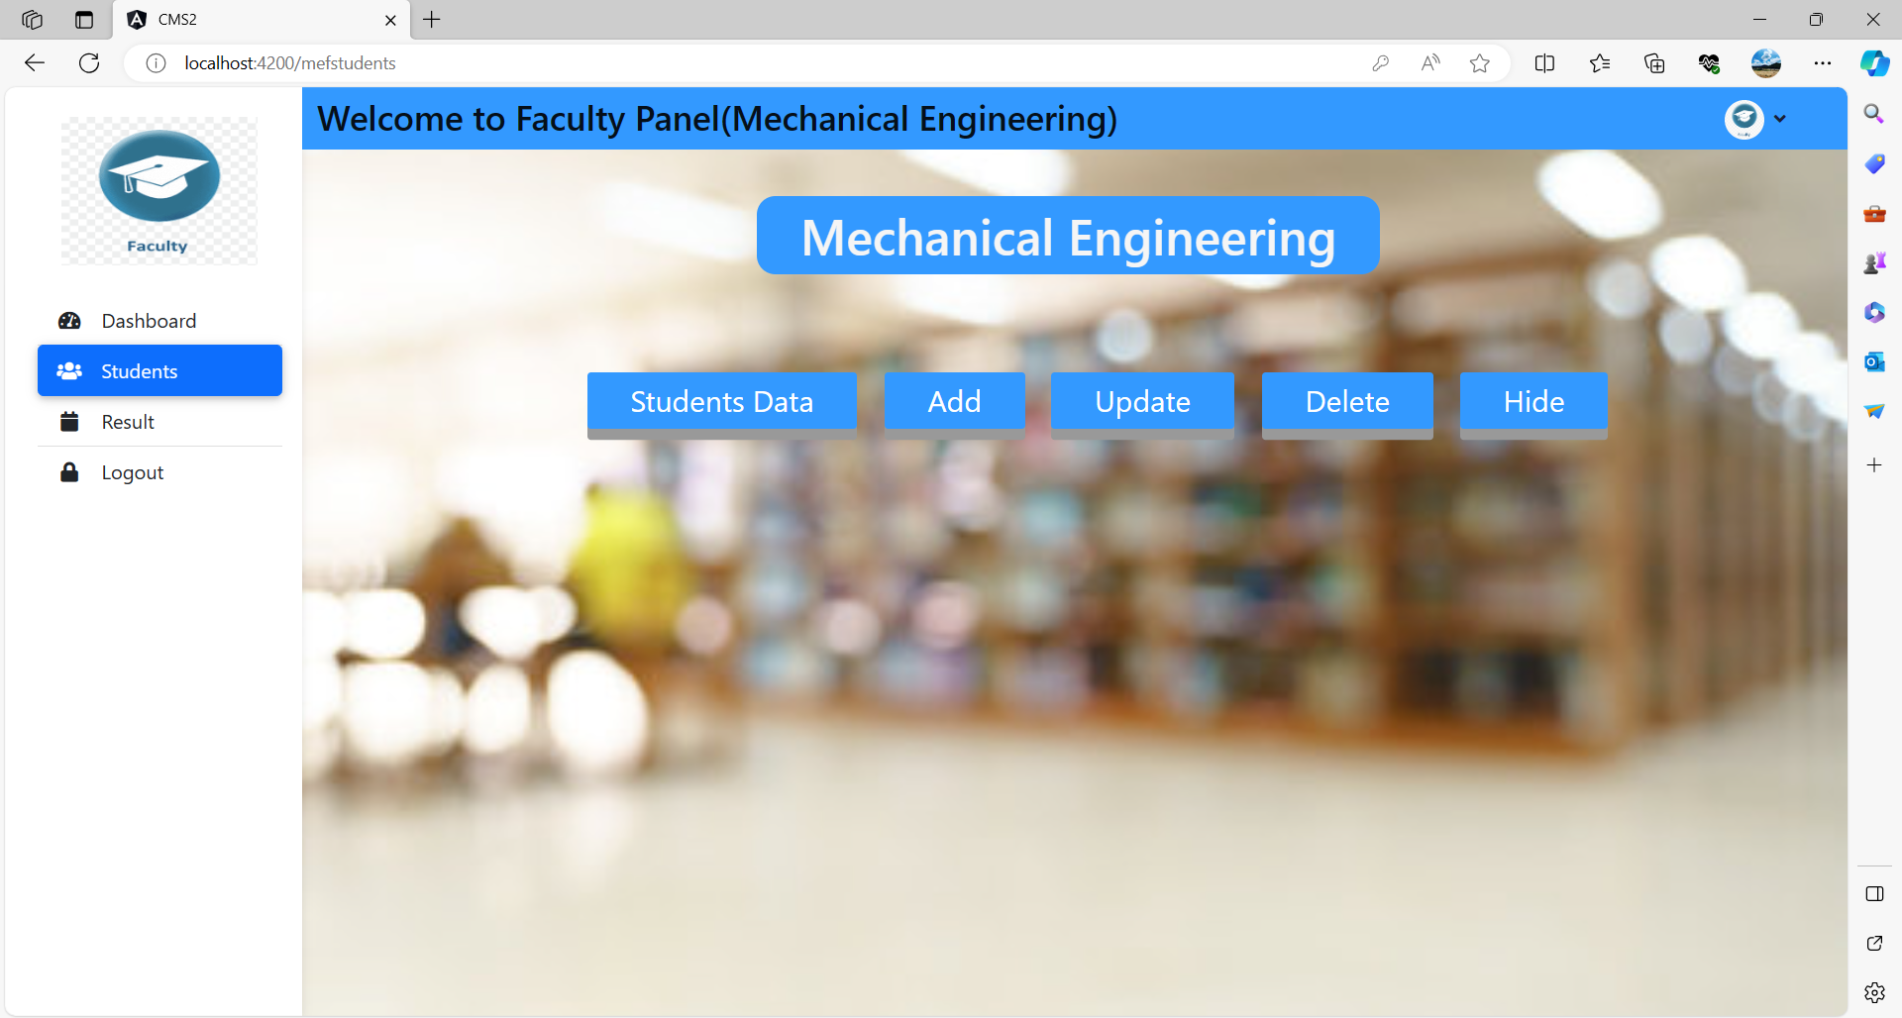
Faculty Panel (Student):

Slide 21
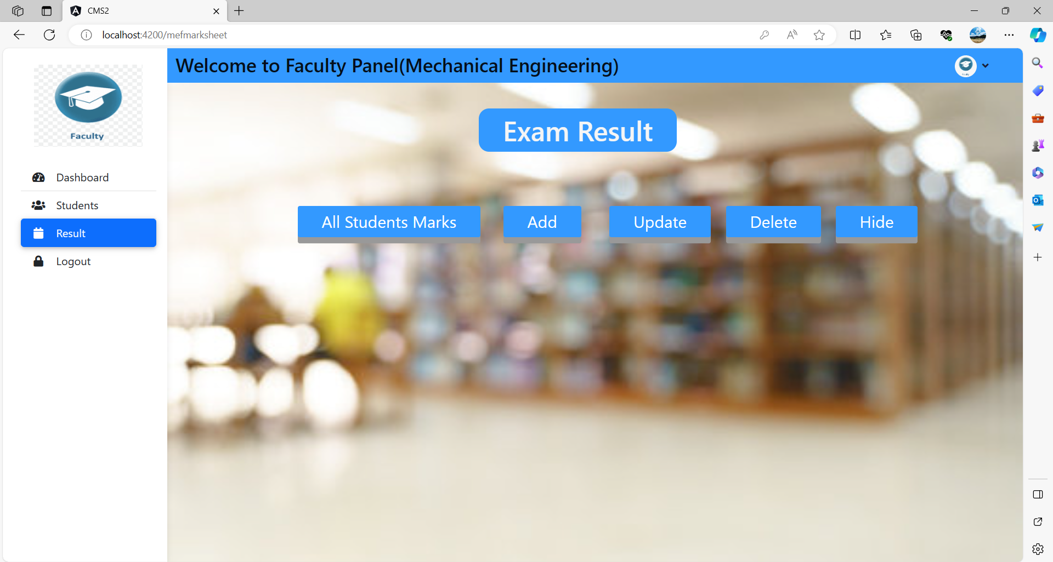
Faculty Panel (Result):

Slide 22
Students Module:
Login
Dashboard
Result
Fees

Slide 23
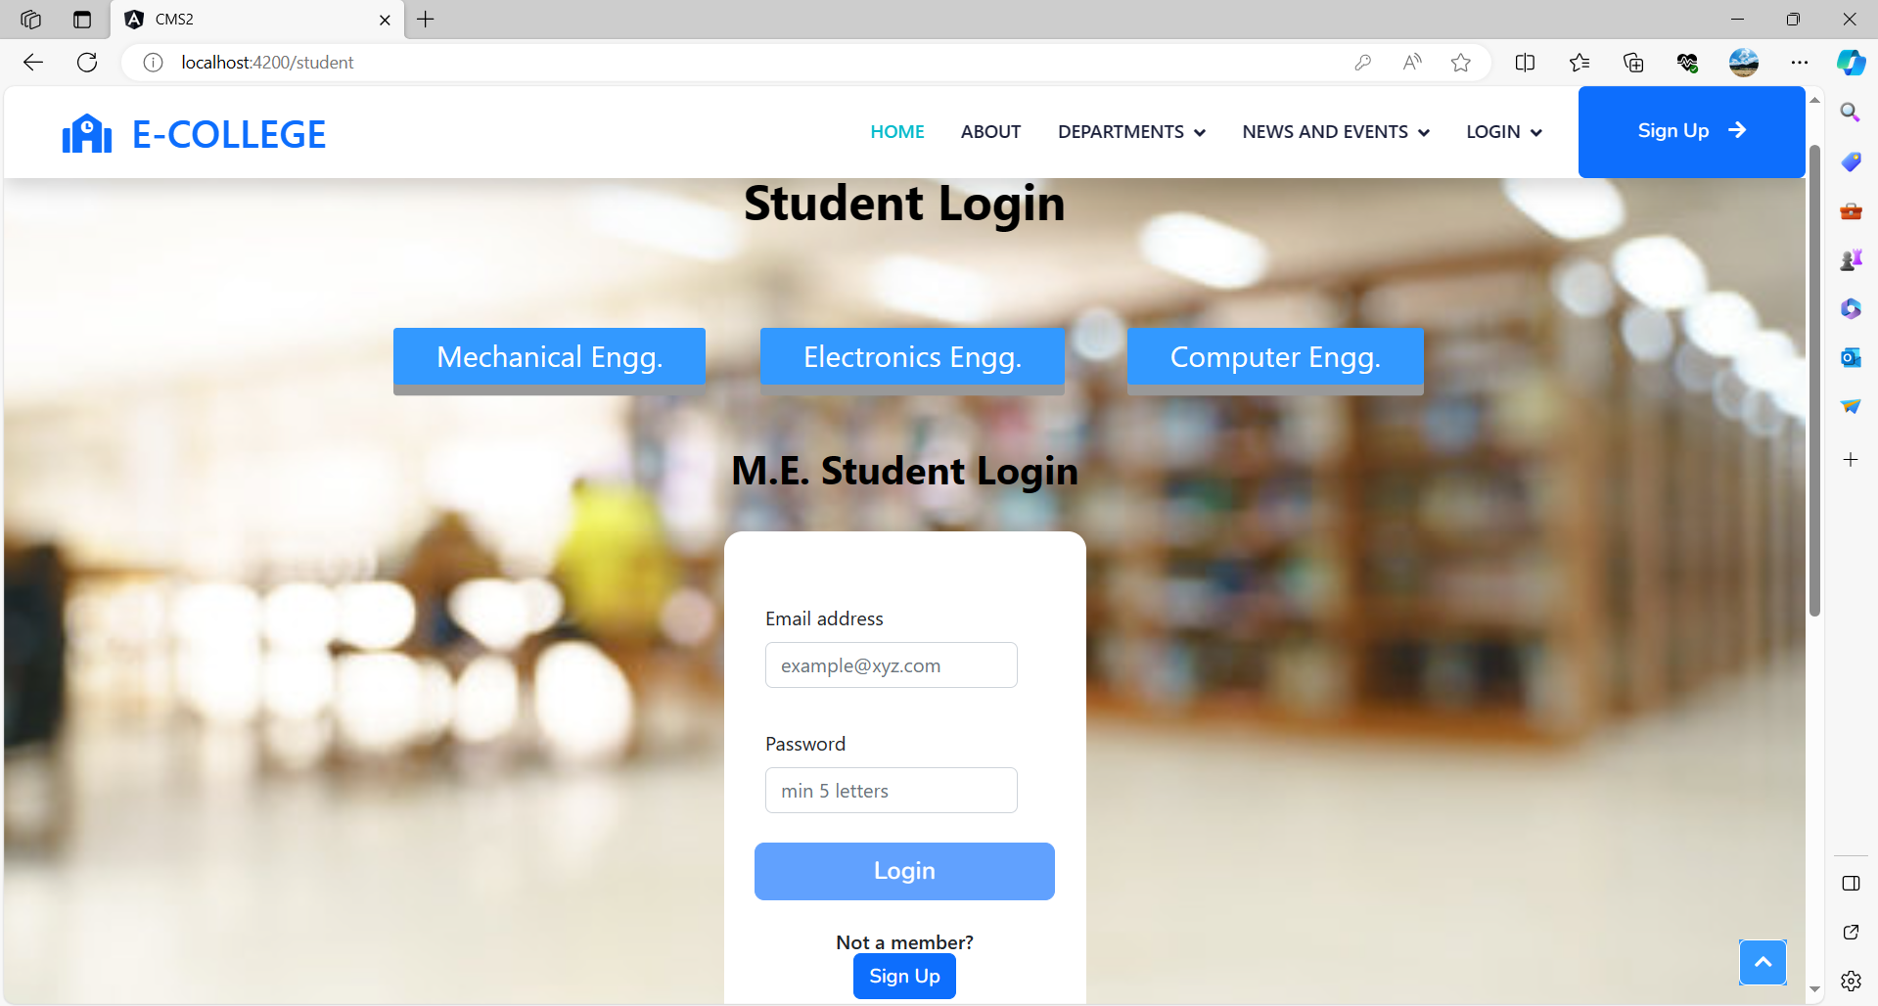
Student Panel (login):

Slide 24
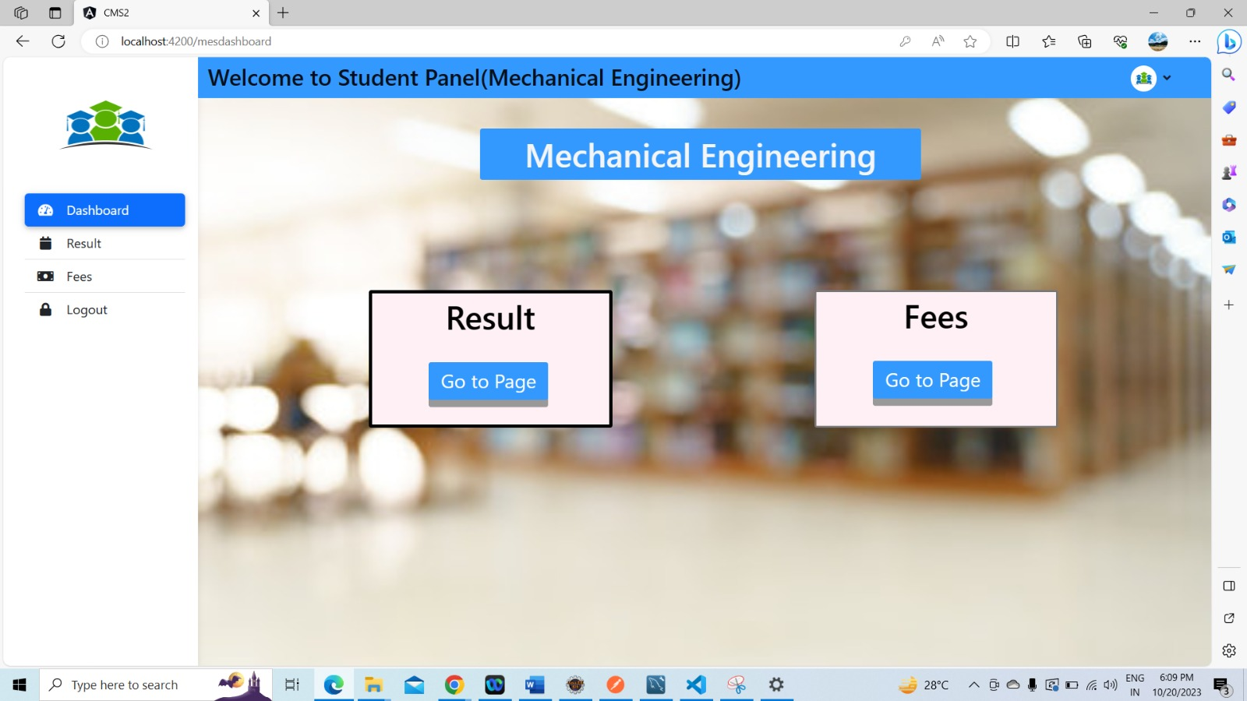
Student Panel(Dashboard):

Slide 25
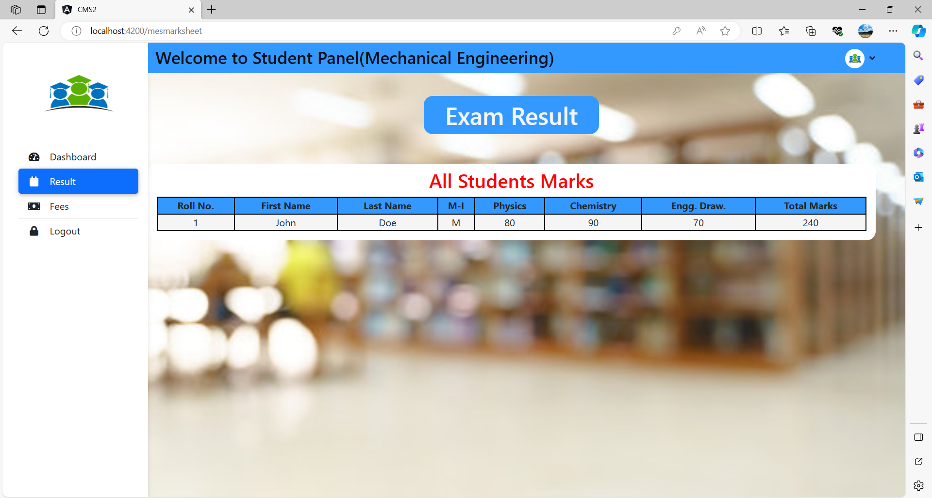
Student Panel(Result):

Slide 26
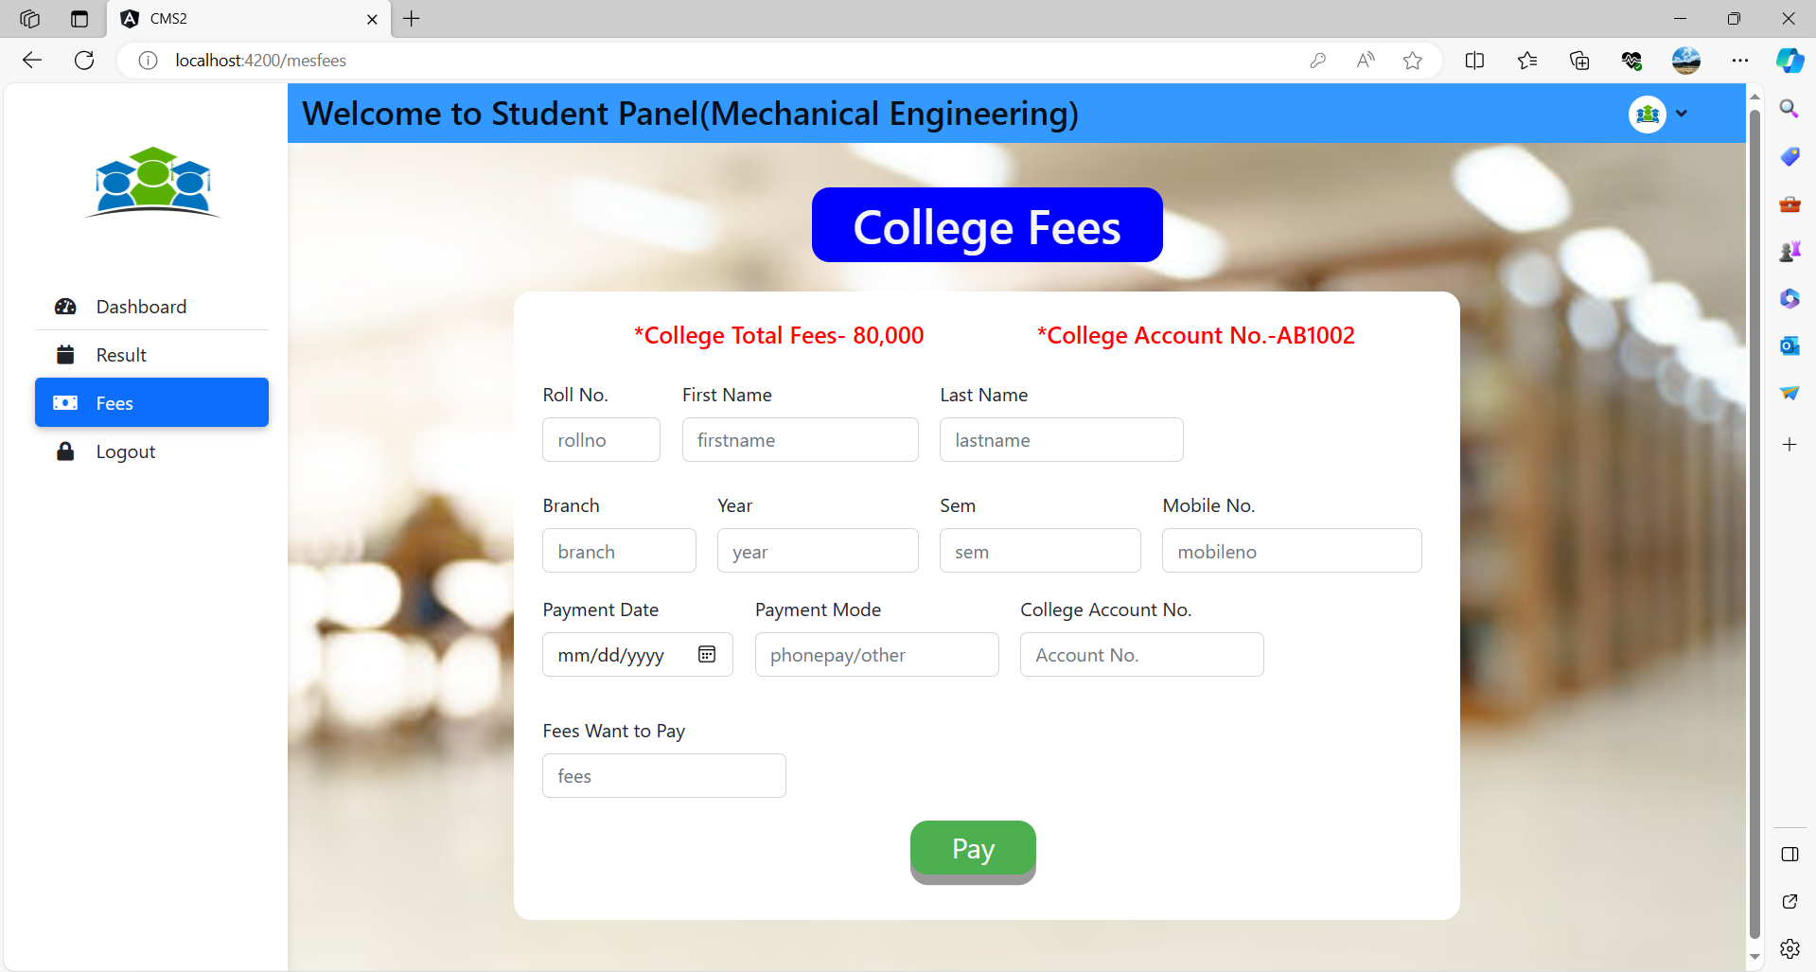
Student Panel(Fees):

Slide 27
E-R Diagram:
Email
LName
FName
PassWord
ID
Admin
Branch Name
Email
1
1
Student Names
M
Student
Adds
Enters
Gender
Password
M
ID
1
Enrolls
1
Branch
Semesters
Branch Name
Phone No
Year
1
Assigned
ID
ID
Email
1
Gender
FName
M
Maintains
1
Result
Faculty
Fname
LName
LName
Subjects Names
Total Marks
Phone No
Password
Designation

Slide 28
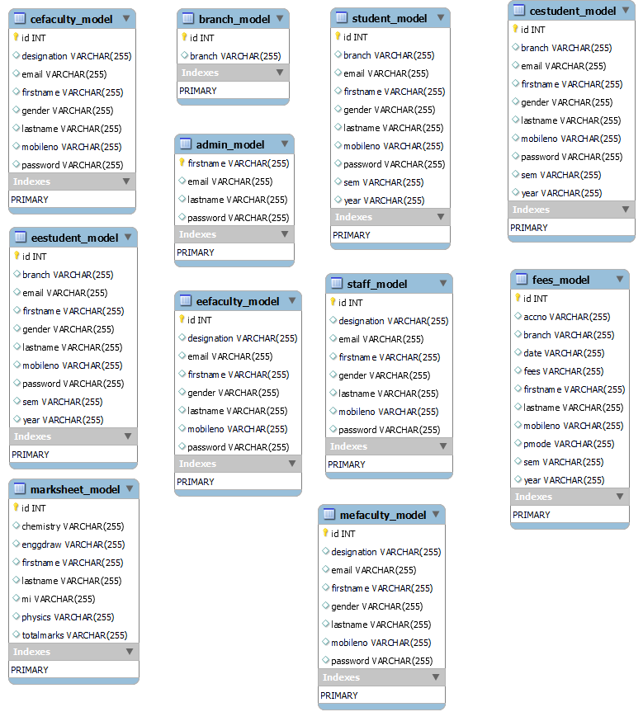
Database Schema:

Slide 29
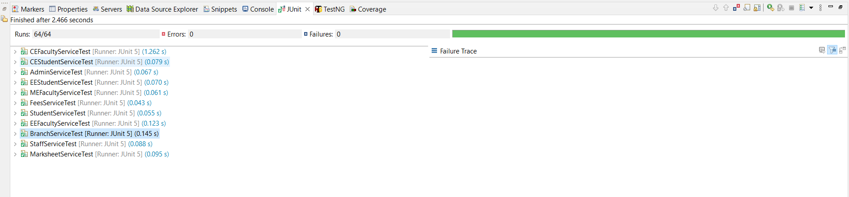
Unit Testing:

Slide 30
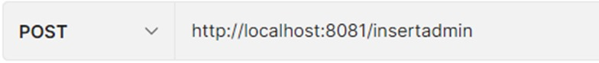
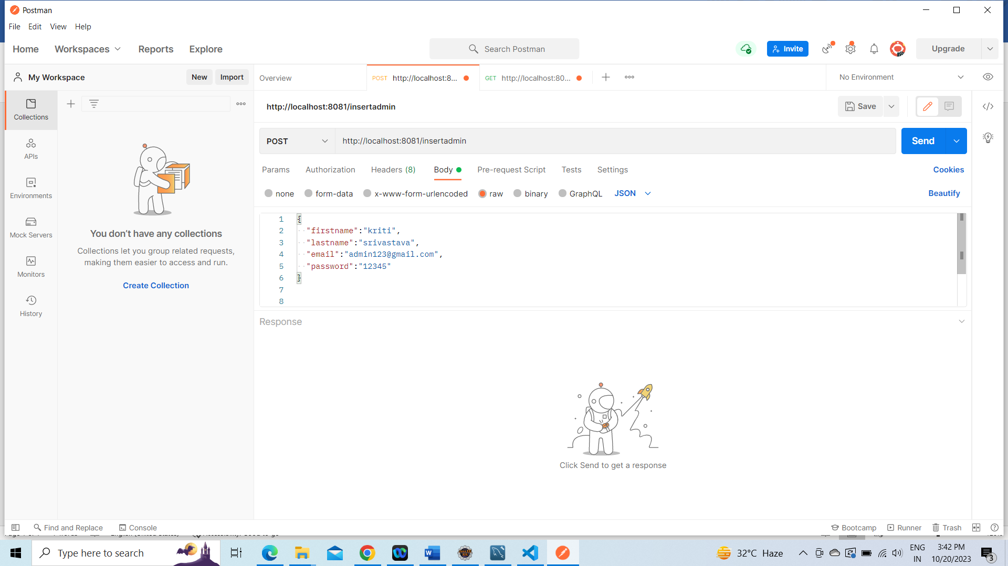
Functional Testing:

Slide 31
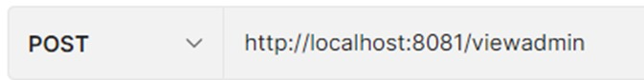
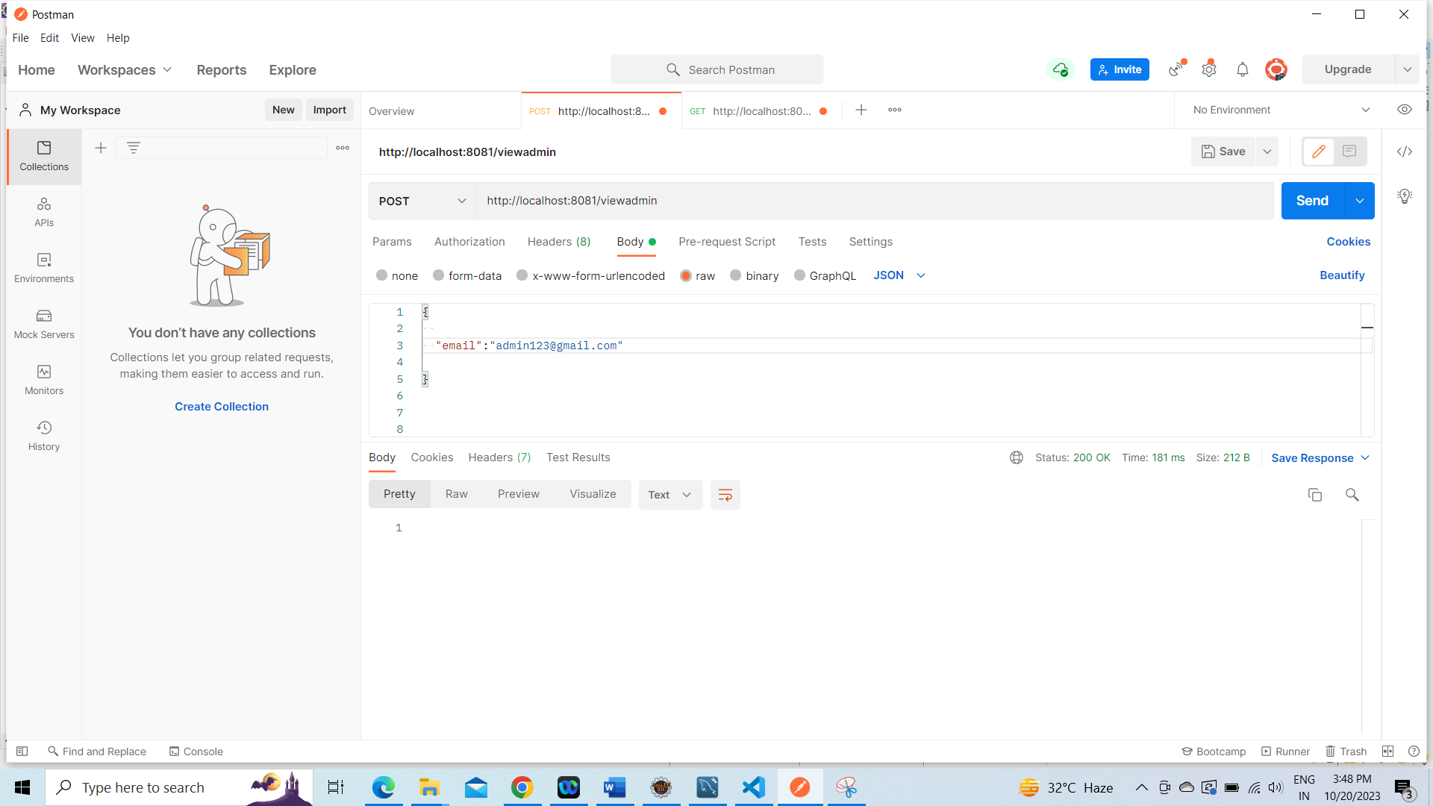
Functional Testing:

Slide 32
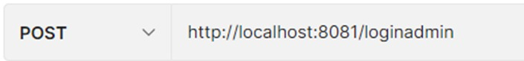
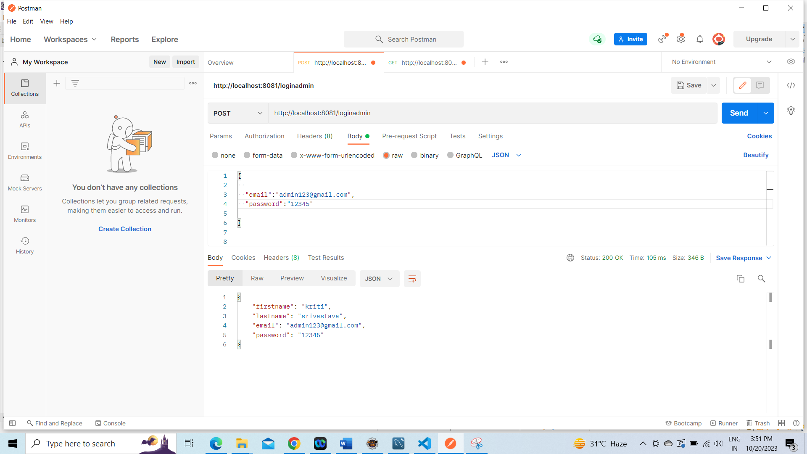
Functional Testing:

Slide 33
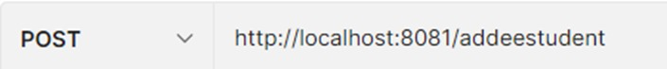
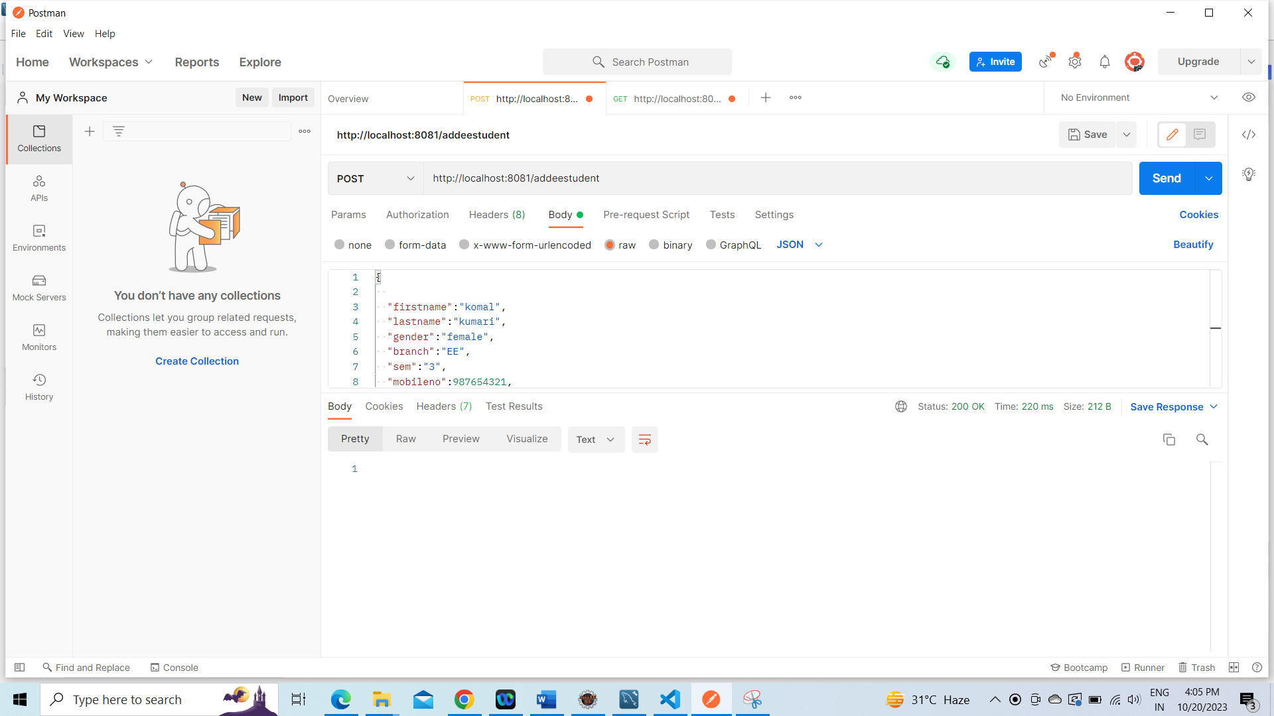
Functional Testing:

Slide 34
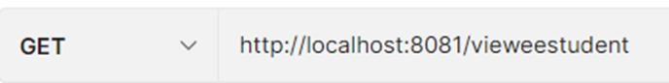
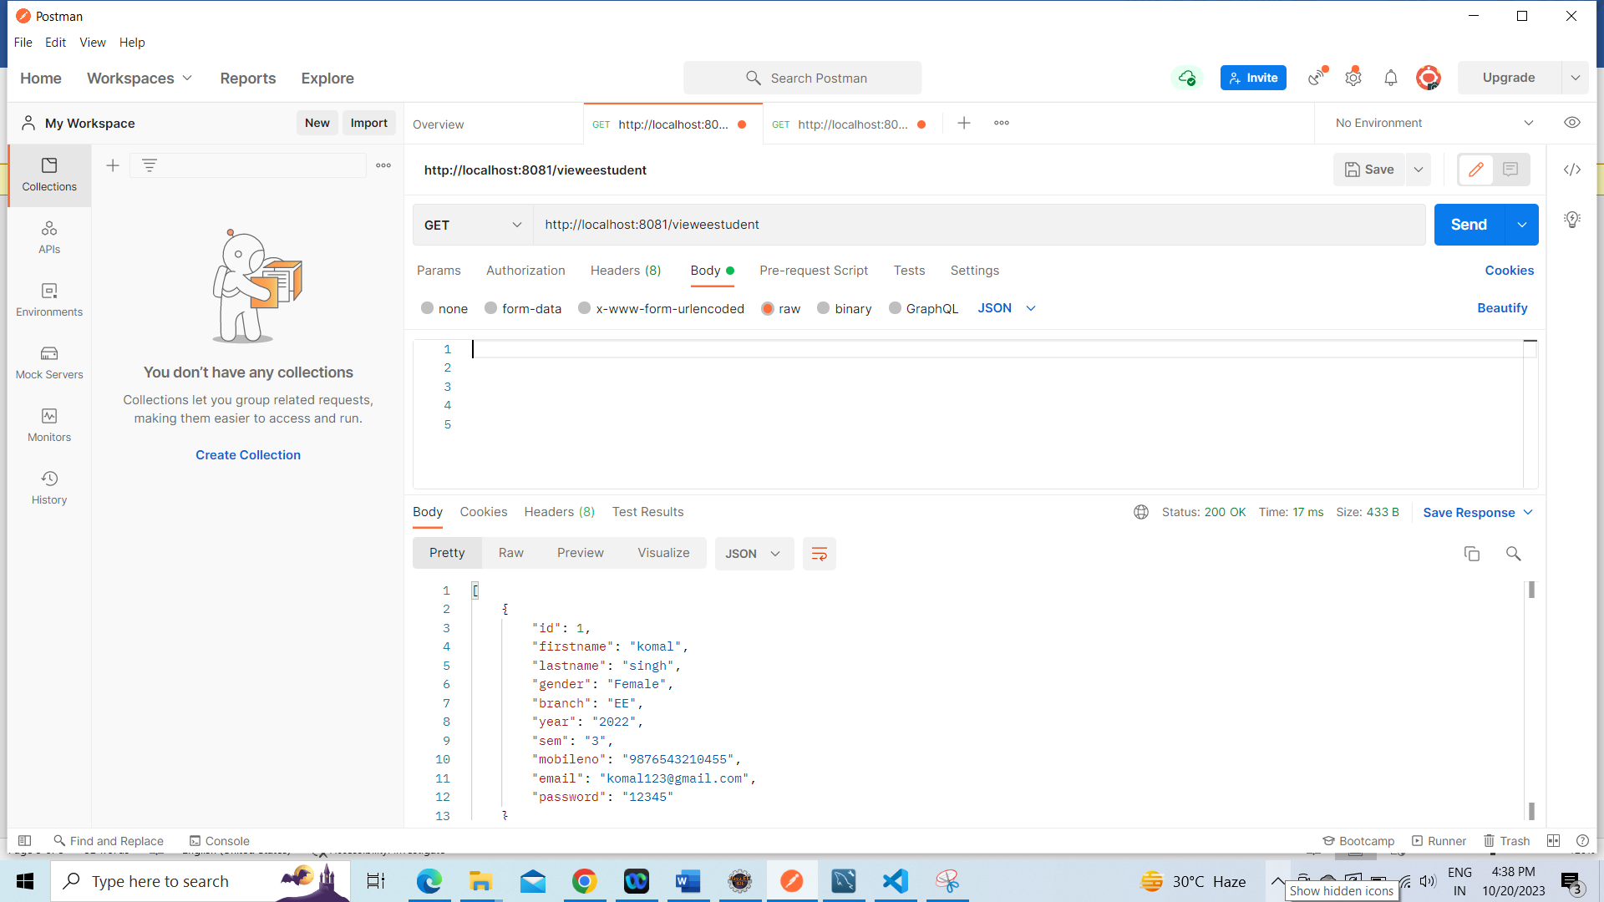
Functional Testing:

Slide 35
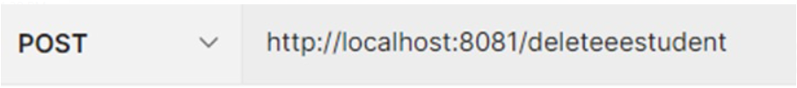
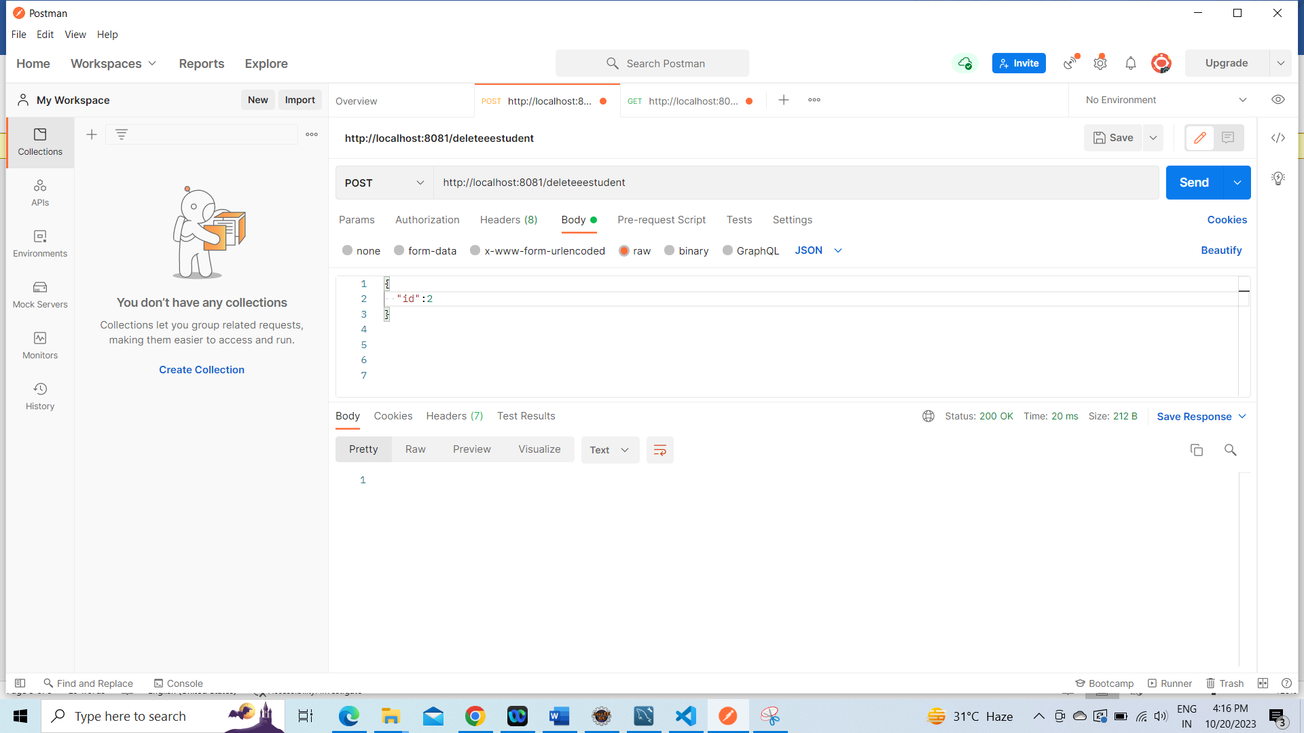
Functional Testing:

Slide 36
Future Scope
In Future, we can add many- more functionalities in our project by taking the given ideas and points and we can enhance this project that can be easily accessible and will look more interactive.
Mobile Applications
Enhanced Security
E-Learning Integration
AI-driven Chatbots

Slide 37
Conclusion
Finally, The project entitled as College Management System is the system that deals with the information of all student details
System leads to instant updates for all student any where physical.
Its also connect to parent about the ongoing progress in college/school
Overall Impact.

Slide 38
THANK YOU

